Slide 1
Apriori Algorithm

Slide 2
Introduction to
Apriori Algorithm
Apriori is an algorithm for frequent item set mining and association rule learning over relational databases .It produce larger and larger item sets as long as those item sets appear sufficiently often in the database.

Slide 3
Metrics in
Apriori Algorithm
Support
Antecedent Support
Consequent Support
Confidence
Lift
Leverage
Conviction
Zhang’s Metric

Slide 4
Support
Definition: The proportion of transactions that contain the antecedent itemset in a rule.
Purpose: Measures how often the antecedent itemset appears in the dataset.
Formula:(No of transactions containing A)/(Total no of transaction)

Slide 5
Antecedent Support
Definition: The proportion of transactions in the dataset that contain a particular itemset.
Purpose: Indicates how frequently the itemset appears in the dataset.
Formula:(No of transactions containing A[itemset])/(Total no of transaction)

Slide 6
Consequent Support
Definition: The proportion of transactions that contain the consequent itemset in a rule.
Purpose: Measures how often the consequent itemset appears in the dataset.
Formula:(No of transactions containing B)/(Total no of transaction)

Slide 7
Confidence
Definition: The proportion of transactions containing the antecedent that also contain the consequent.
Purpose: Indicates the likelihood that the consequent itemset is purchased when the antecedent itemset is purchased.
Formula:Confidence(A→B)=Support(A U B)/Support A

Slide 8
Lift
Definition: The ratio of the observed support to the expected support if the antecedent and consequent were independent.
Purpose: Measures how much more likely the consequent itemset is purchased when the antecedent itemset is purchased, compared to the overall likelihood of purchasing the consequent itemset.
Formula:Confidence(A→B)=Support(A U B)/(Support A*Support B)

Slide 9
Leverage
Definition: The difference between the observed support and the expected support if the antecedent and consequent were independent.
Purpose: Measures the additional support gained by having the antecedent and consequent itemset together, compared to what would be expected if they were independent.
Formula: Leverage(A→B)=(Support(AUB)-Support(A)*Support(B))

Slide 10
Conviction
Definition: A measure of the implication strength of the rule, calculated as (1 - consequent support) divided by (1 - confidence).
Purpose: Measures the strength of the implication of the rule, with higher values indicating stronger rules. It is interpreted as the number of times we would expect 𝐴
A to appear without 𝐵 if A and 𝐵 were independent.
Formula:Conviction(A→B)=(1-Support(B))/(1-Confidence(A→B))

Slide 11
Zhang’s Metric
Definition: A metric that evaluates the strength of the rule by considering both the antecedent and the consequent.
Purpose: Evaluates the strength of the association rule while addressing some of the limitations of other metrics like lift and confidence. Higher values indicate stronger associations.
Formula: Zhang’s Metric(A→B)=(Support(AUB)-(Support(A)*Support(B)))/max(Support(A)*(1-Support(B)),Support(B)*(1-Support(A))

Slide 12
Let’s Take a Real Life Example
Transaction ID | Item Brought
1 | Milk, Bread, Butter
2 | Milk, Bread
3 | Bread, Butter
4 | Milk, Butter
5 | Bread, Butter
6 | Milk, Bread, Butter

Slide 13
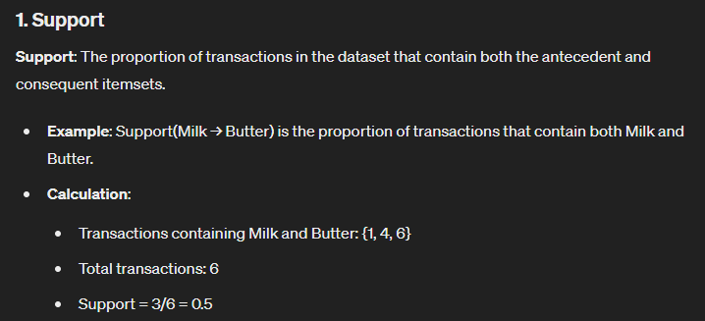
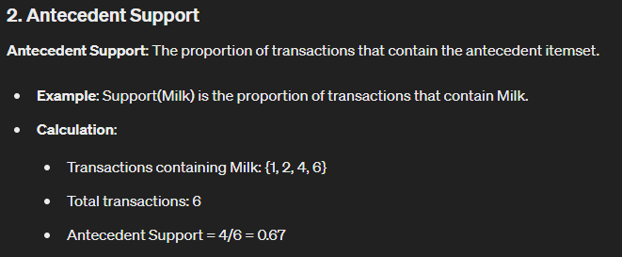
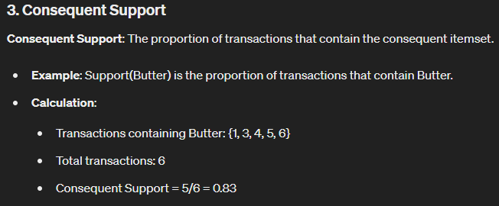
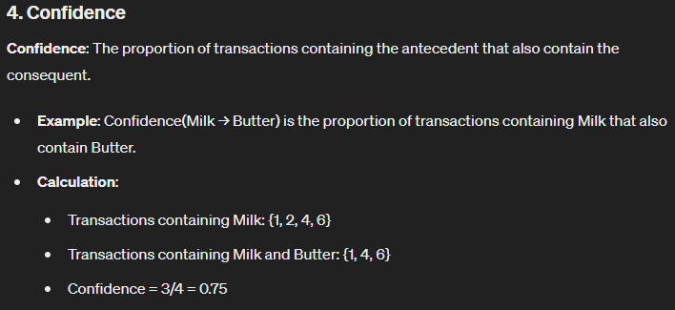

Slide 14
